Slide 1

OBJECT ORIENTED PROGRAMMING SESSIONAL
COURSE CODE: CSE 212
Project Name: Smart Shopping Complex Management System
PRESENTED TO:
Md. Muhtadir Rahman
Department of
Computer Science and Engineering,
Port City International University.
PREPARED BY:
Md Minhajul Islam Ishrak (CSE 02107074)
Sweety Rani Majumder(CSE 02107047)
Showrab Barua (CSE 01506381)
Pranta Paul (CSE 02107069)

Slide 2
CONTENTS:
► Problem Statement
►Need
► Motivation
► Requirements
► Stakeholder
► Activity Diagram
► Schema Diagram
► User Interface(UI)
► Cost Analysis
► Thank You
► Q&A

Slide 3
Problem Statement:
This problem is on Smart Shopping Complex System is the automation of registration process of a supermarket.The system is capable to provide much information such as customers Id,product name,quantity,price.The system allows us to add records when a customer buy something.It also allows us to update or delete a product based on customers requirements.For storing and retrival,we use the MySQL database.It enable us to add any number of records in our database from the frontend which is Java core.Any changes made in frontend will be reflected at the backend.

Slide 4
Need:
Electronically handling of customers purchase’s record to enhance the accuracy,flexibity,reliablity,reliability and to remove the human error.An smart Smart Shopping Complex System for customer, generally with a recognized operating.To provide accurate information about the addition, deletion, and modified product data.To provide, efficient, accurate, reliable, fast, and robust structure that can handle any number of records. The global airline industry continues to grow rapidly, but consistent and robust profitability is elusive.
A few factors that direct us to develop a new system are given below:
►Faster System.
► Accuracy.
► Reliability.
► Informative.
► Order and cancellations from anywhere to any place.

Slide 5
Motivation:
This project on Smart Shopping Complex System is the automation of registration process of a super shop. The system provides information like customer’s ID, list of all passengers, product name,quantity,price.It allows storing and retrieving data related to the super shop and make transactions related to buy a product etc. The system also allows us to add more product even when a customer gets receipt.For data storage and retrieval we use MySQL Database. It enables us to add any number of product in our database. The project “Smart Shopping Complex System” comprises to entry a large number of product which belong to a paricular Super Shop.The system we have implemented manages different objects.

Slide 6
Requirements:
Software Requirement Specifications:
Operating System Front End Back End Server Documentation:
Windows 10
Frontend Software: Java NetBeans 8.2: JDK 8
Backend Software: MySQL
Hardware Specifications:
Asus Laptop.Processor 64bit Ryzen 5,Speed 2.1 GHz Processor.Hard Disk 1TB.RAM 4GB,Graphics card 2GB

Slide 7
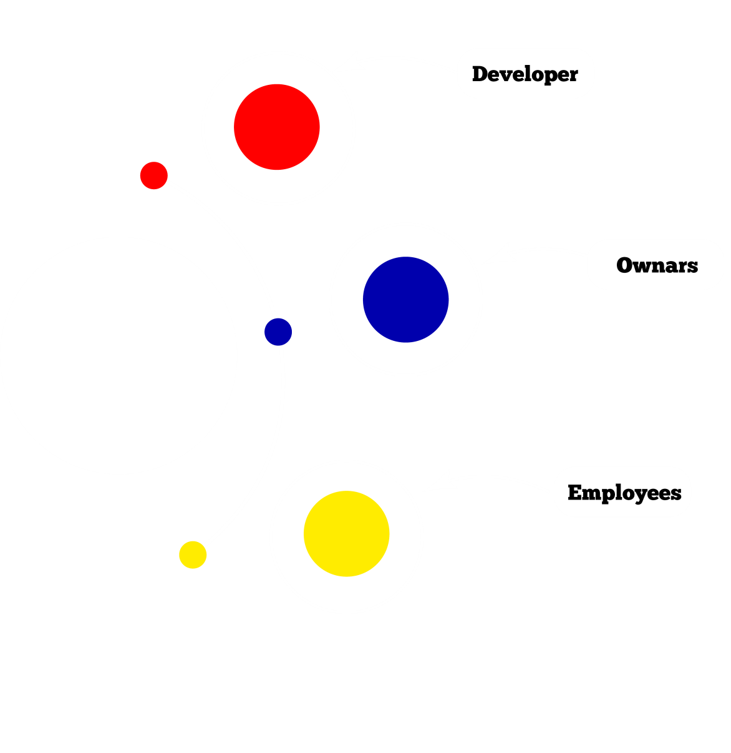
STAKE HOLDER:
▪ Developer will be able to enter full software and they can operate the software with user Id Pass
▪ Owner also access the software for so many reason as like as Security .
▪ Employees must have the Id And password and access to deal with customer.
▪ General people Can access only recept.But they cannot access the software

Slide 8
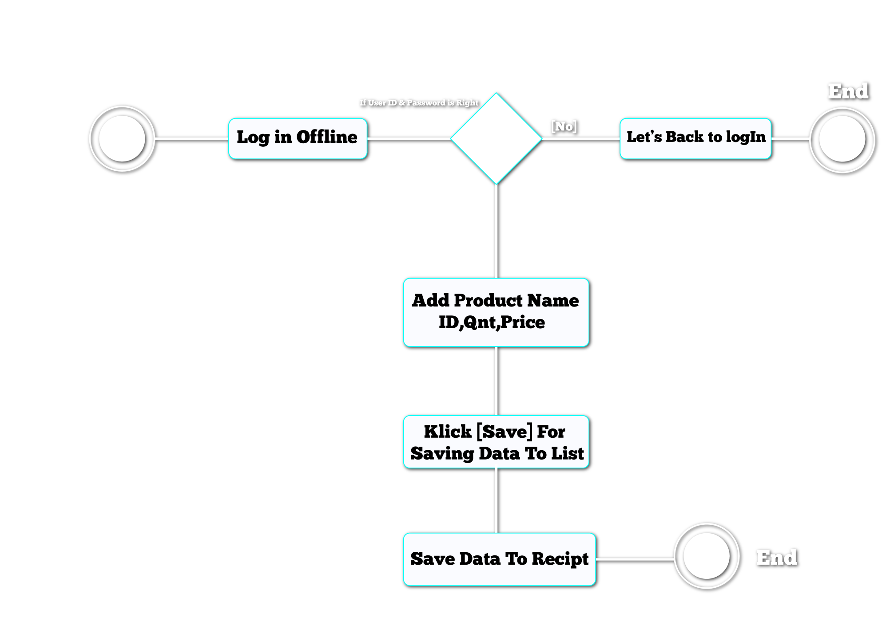
ACTIVITY DIAGRAM :

Slide 9
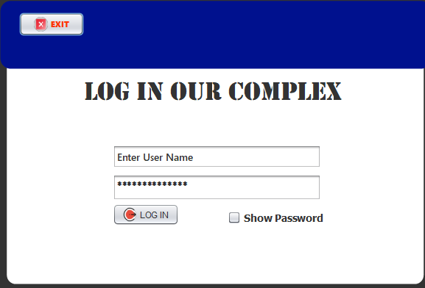
User Interface(UI):
Login Operation

Slide 10
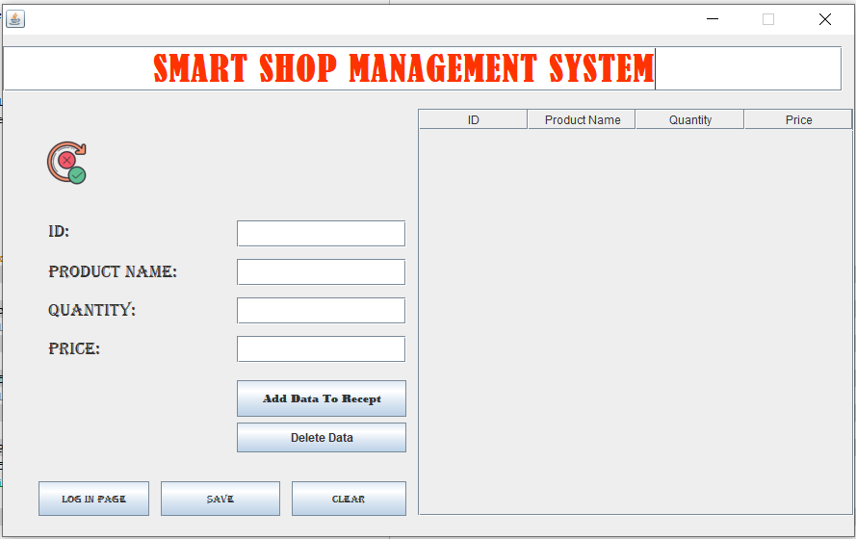
User Interface(UI):
Adding Product From Customer

Slide 11
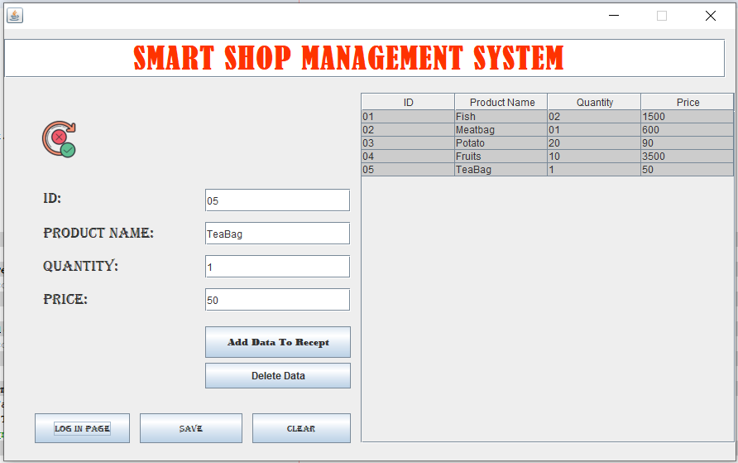
User Interface(UI):
Customer Recipt

Slide 12
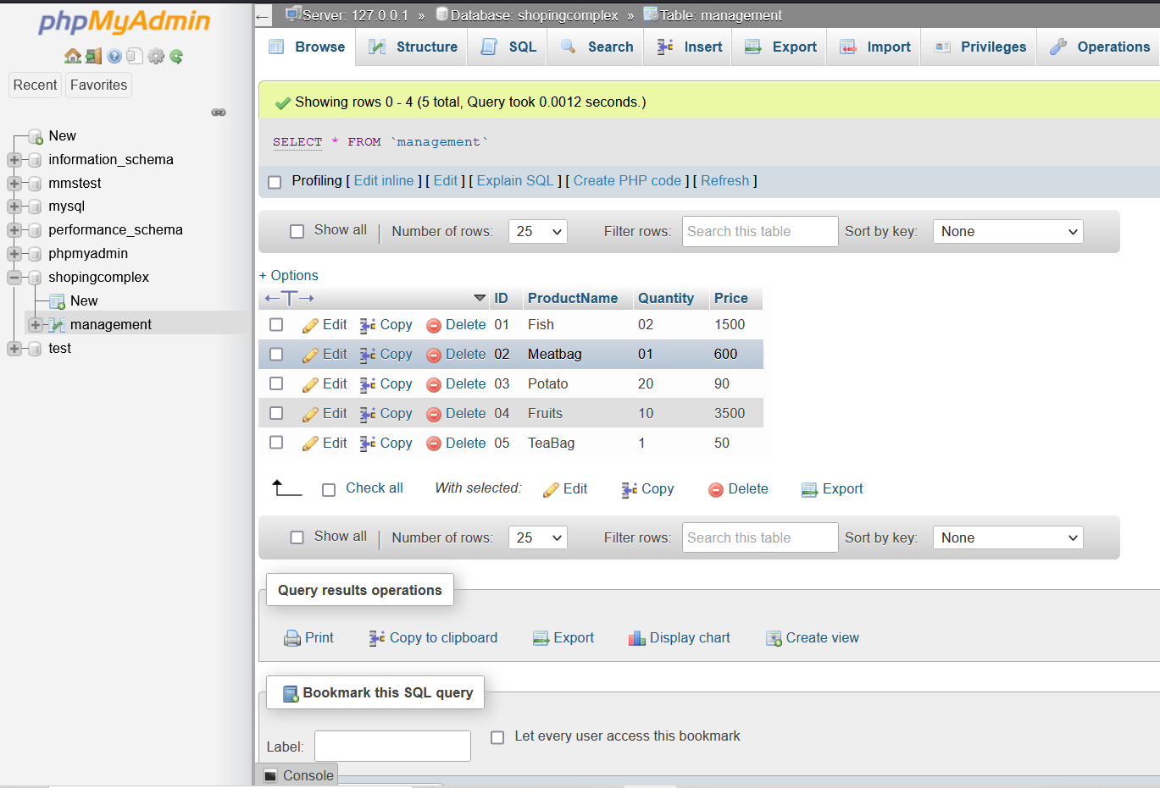
User Interface(UI):

Slide 13
COST ANALYSIS:
Serial No | Item | Amount (BDT)
01 | Software | 1000$(84,000)
02 | Personal PC | 2000$(168,000)
03 | Computer Hardware | 2000$(168,000)
04 | Database Server | 800$(67,000)
05 | Application Software Development | 1000$(84,000)
Total 7800$(655,200)

Slide 14
THANK YOU

Slide 15
Q&A

